Slide 1

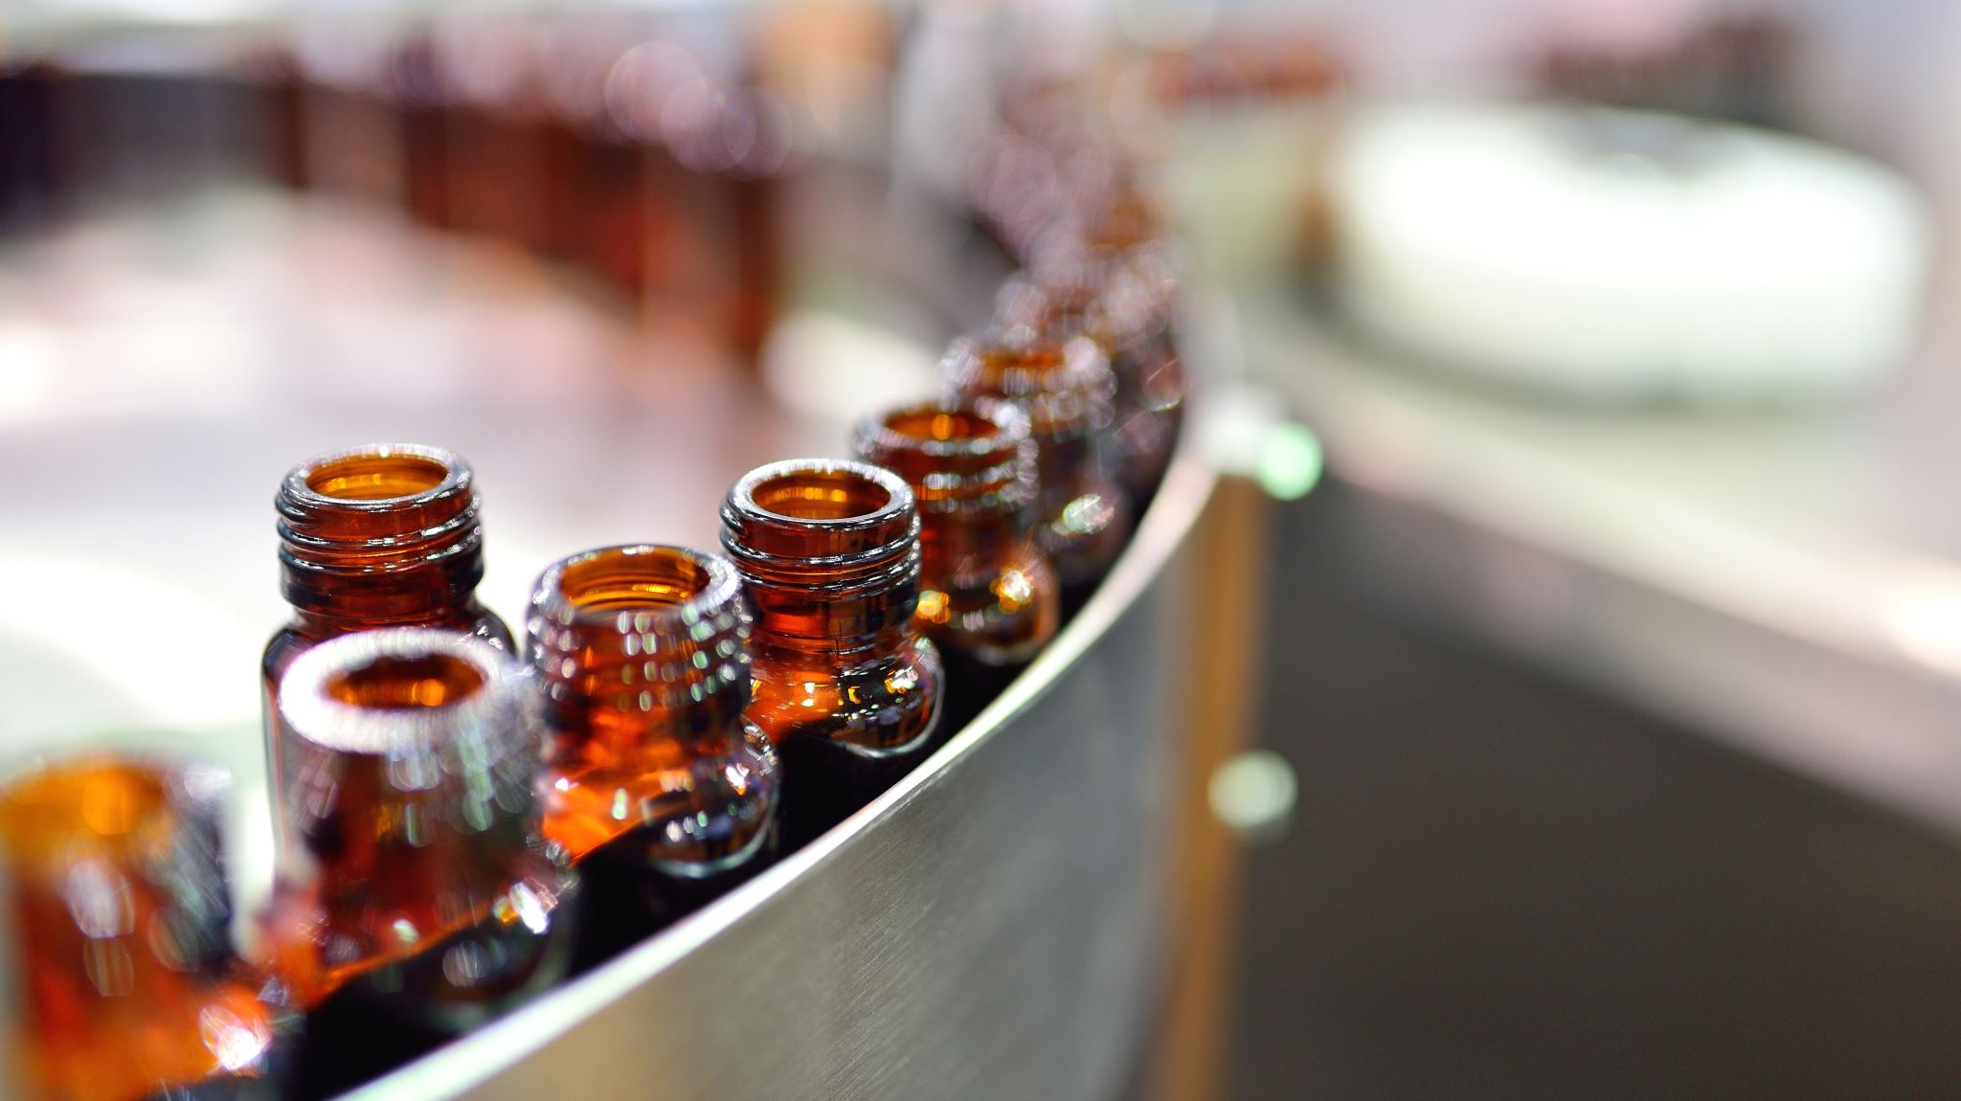
Beers and Breweries: Analysis for Budweiser
Joel Laskow and Renu Karthikeyan

Slide 2
Statement of Purpose
The purpose of this presentation is to outline the results of our exploratory analysis of beer and brewery data from Budweiser
Notes:
Joel

Slide 3
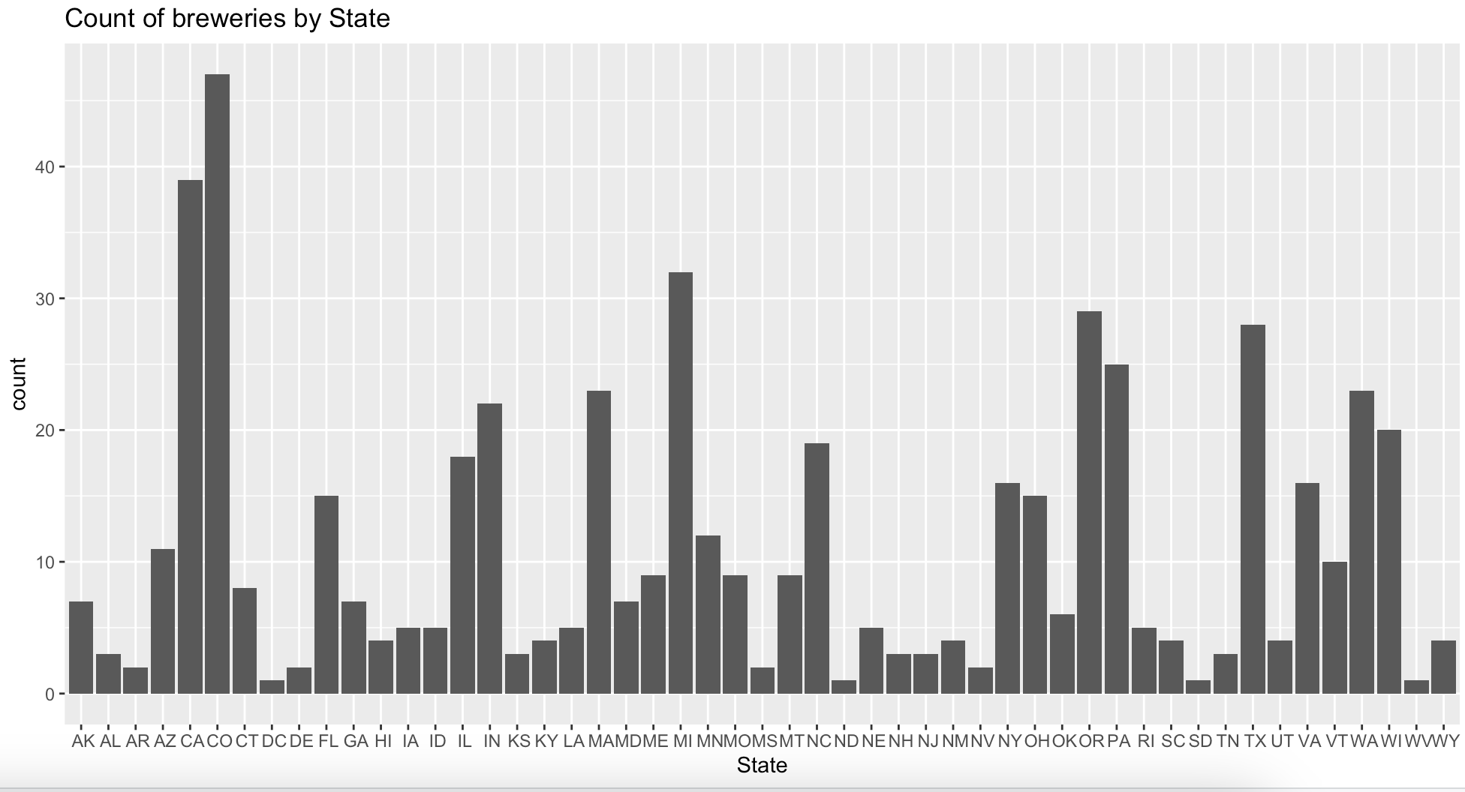
Number of Breweries by State
Notes:
Joel

Slide 4
Number of Breweries by State
States With the Most Breweries:
CO
CA
Notes:
Joel

Slide 5
Number of Breweries by State
States With the Most Breweries:
CO
CA
Economic fluctuations within these 2 states might have the greatest impact on production
Notes:
Joel

Slide 6
Number of Breweries by State
States With the Most Breweries:
CO
CA
Economic fluctuations within these 2 states might have the greatest impact on production
Drought
Notes:
Joel

Slide 7
Number of Breweries by State
States With the Most Breweries:
CO
CA
Economic fluctuations within these 2 states might have the greatest impact on production
Drought
Recession
Notes:
Joel

Slide 8
Number of Breweries by State
States With the Most Breweries:
CO
CA
Economic fluctuations within these 2 states might have the greatest impact on production
Drought
Recession
Supply Chain Issues
Notes:
Joel

Slide 9
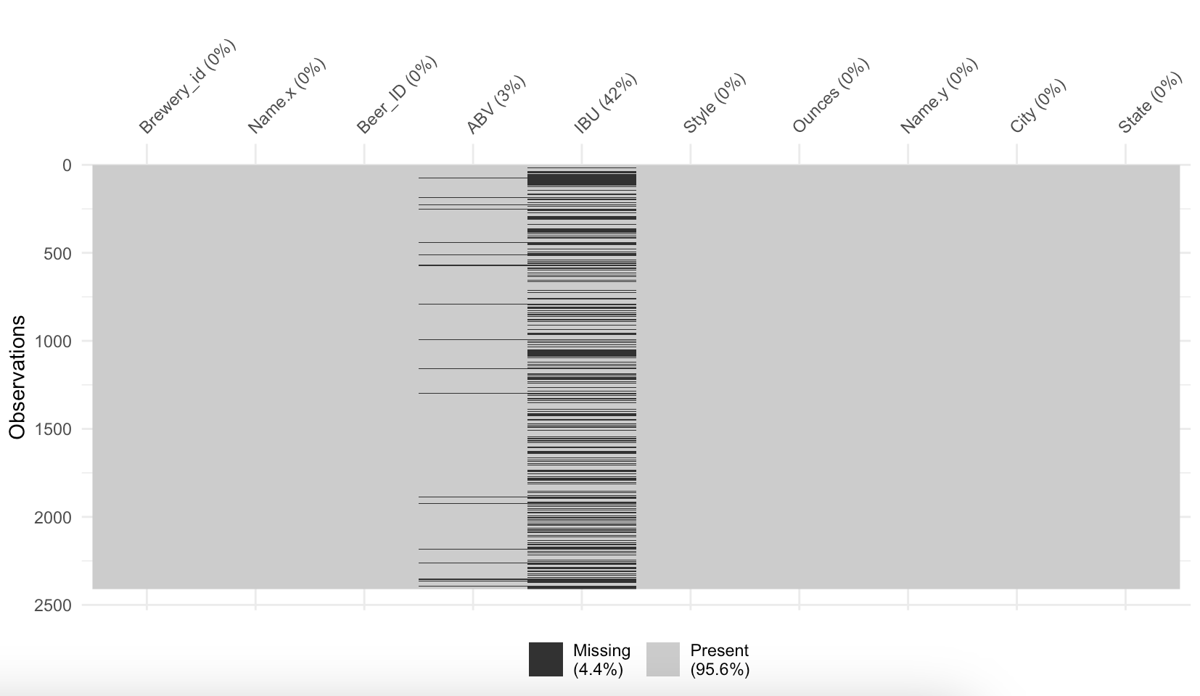
Caveats:
Missing Values in our Data
3% of ABV values are missing
Notes:
R: 2 options to go about it – removing all the observations 🡪 a lot of missing data 🡪 42% 2410 observations would be disregarded; decided to impute to maintain the number of observations to provide more accurate results

Slide 10
Caveats:
Missing Values in our Data
3% of ABV values are missing
42% of IBU values are missing
Notes:
R: 2 options to go about it – removing all the observations 🡪 a lot of missing data 🡪 42% 2410 observations would be disregarded; decided to impute to maintain the number of observations to provide more accurate results

Slide 11
Caveats:
Missing Values in our Data
3% of ABV values are missing
42% of IBU values are missing
Missing values were imputed with the column means
Notes:
R: 2 options to go about it – removing all the observations 🡪 a lot of missing data 🡪 42% 2410 observations would be disregarded; decided to impute to maintain the number of observations to provide more accurate results

Slide 12
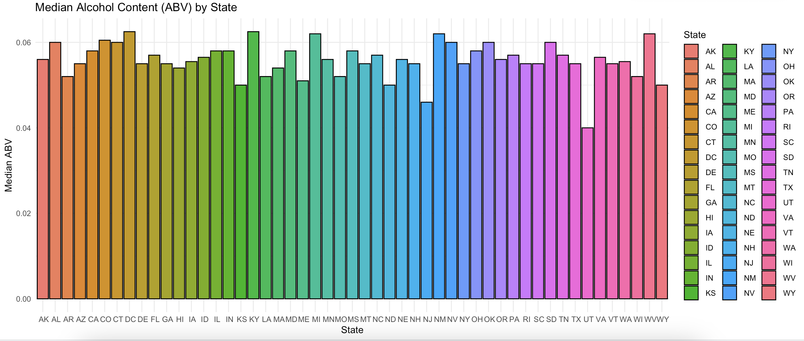
Median Alcohol Content by State
Notes:
Joel

Slide 13
Median Alcohol Content by State
States with highest alcohol content:
DC
KY
MI
NM
WV
Notes:
Joel

Slide 14
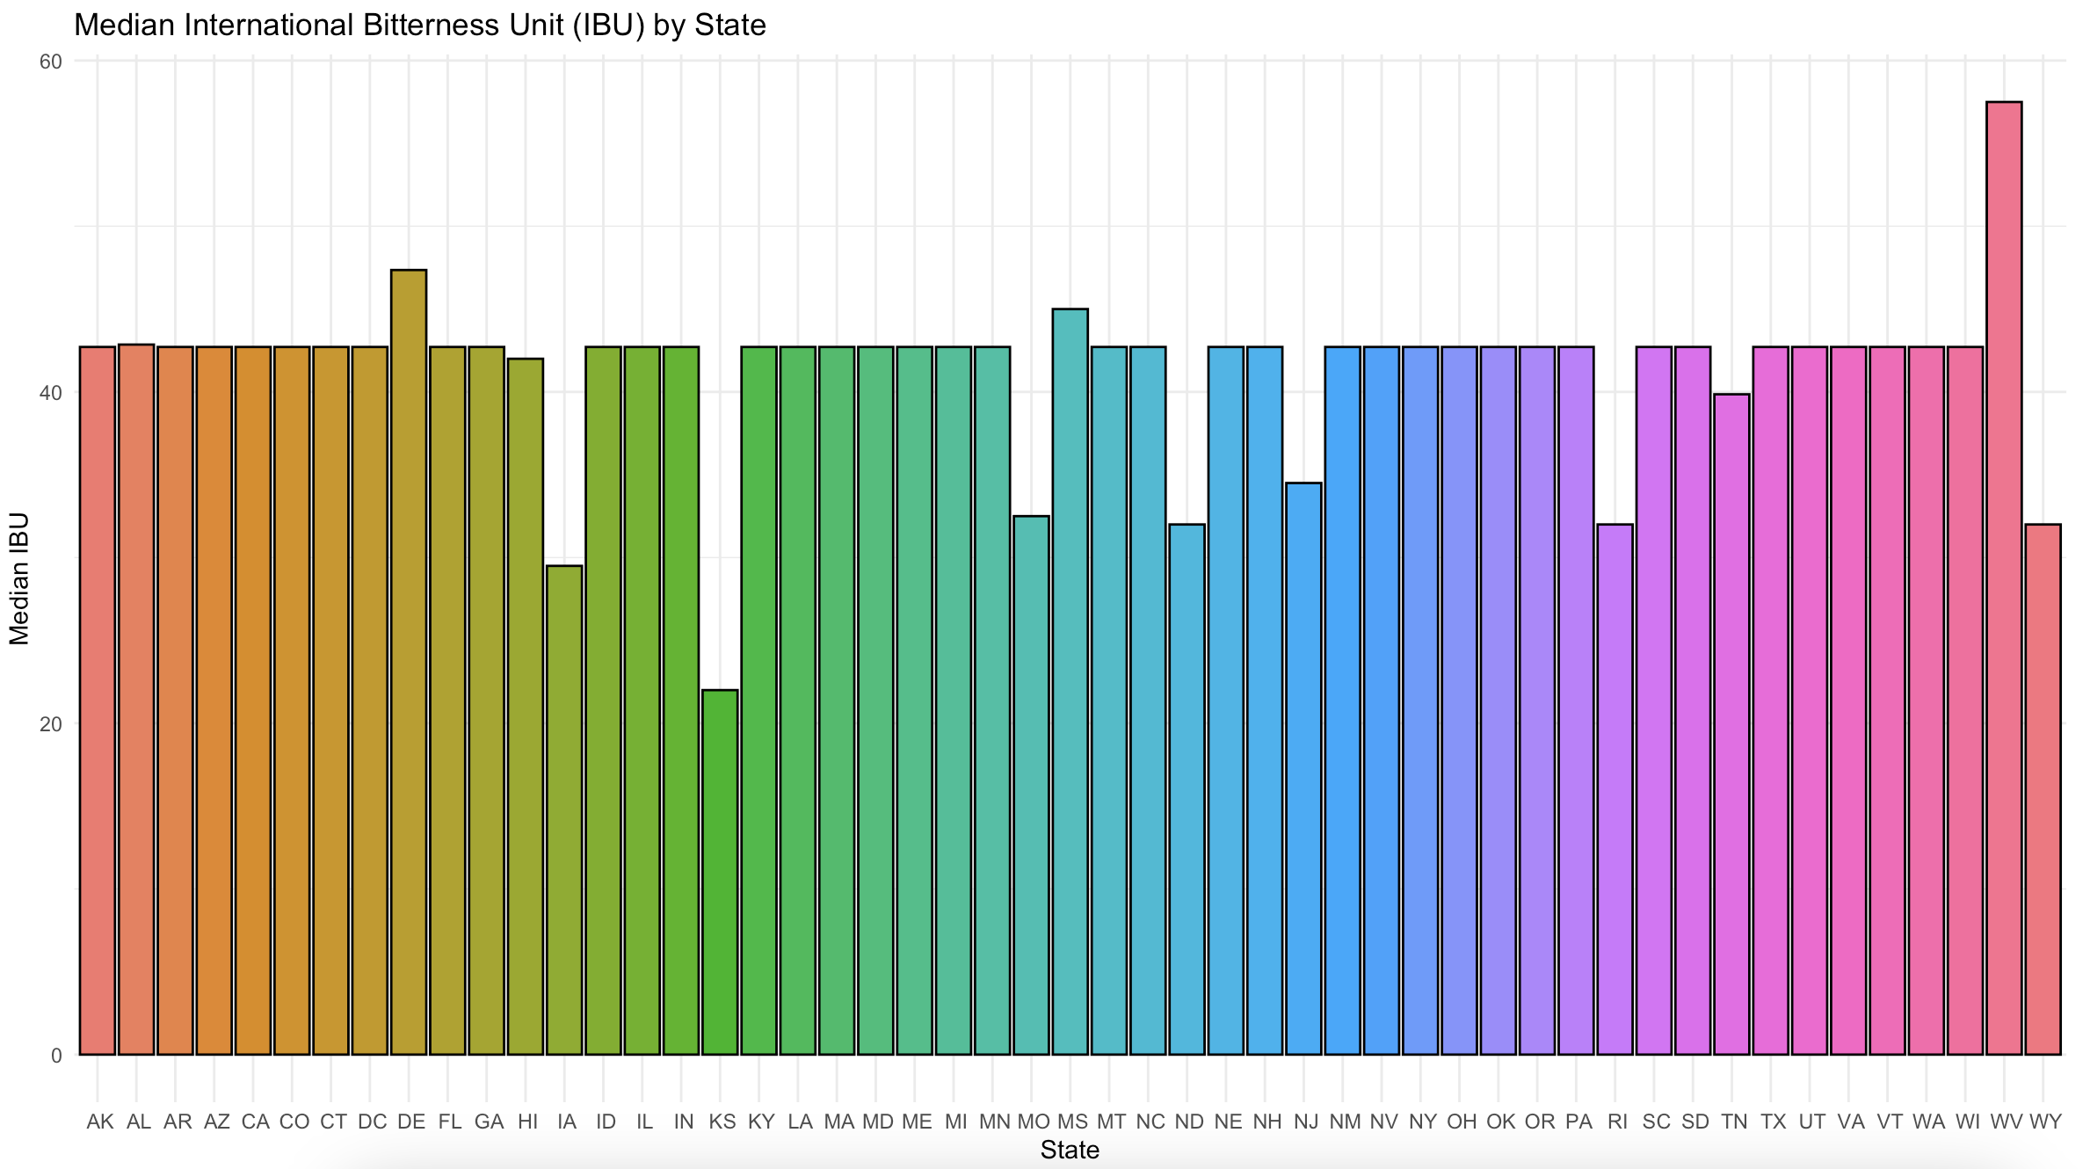
Median Bitterness by State
Notes:
Renu; West virginia
[This is with imputed means. Makes sense that so many of the Median IBUs are equivalent, since 42% of the IBU data was originally missing; not necessarily accurate, but the data is homogenous. Better estimate 🡪 getting IBU values for each group

Slide 15
Median Bitterness by State
State with highest median IBU:
WV
Notes:
Renu; West virginia
[This is with imputed means. Makes sense that so many of the Median IBUs are equivalent, since 42% of the IBU data was originally missing; not necessarily accurate, but the data is homogenous. Better estimate 🡪 getting IBU values for each group

Slide 16
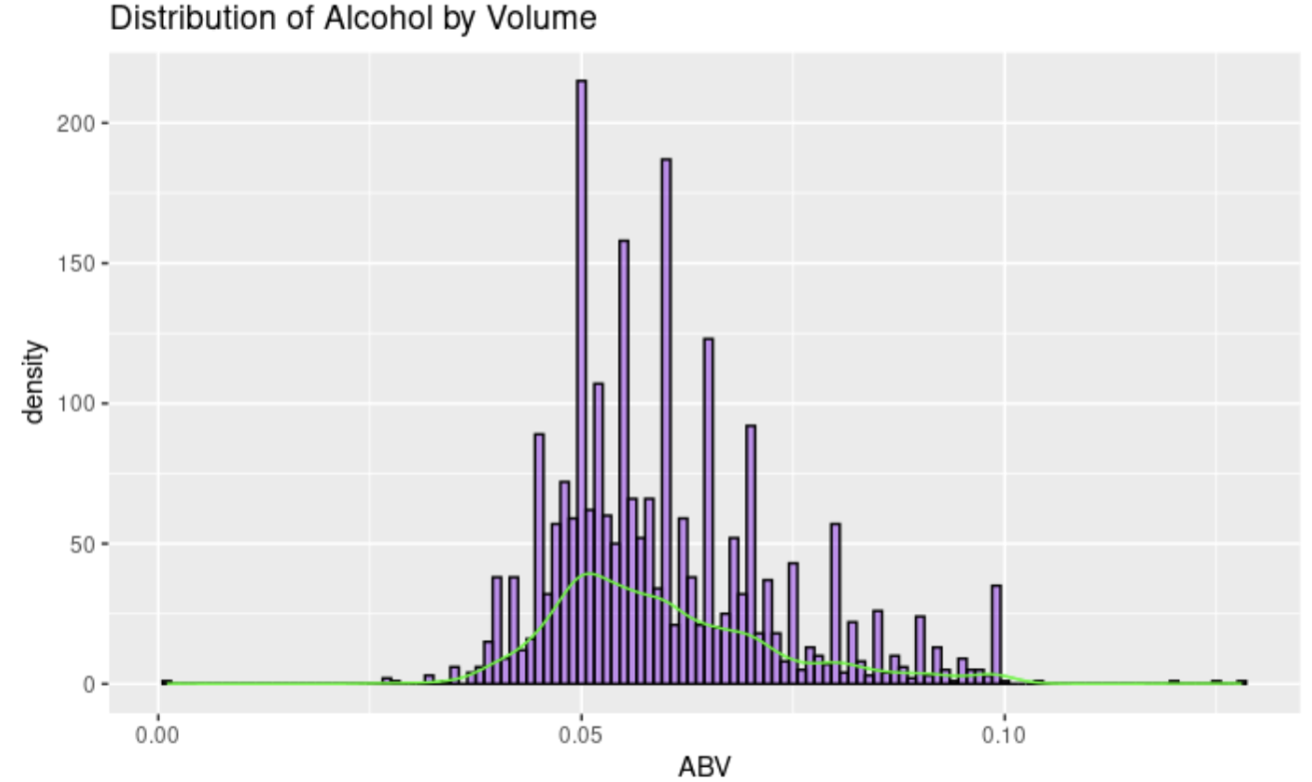
Alcohol Content Distribution
Notes:
Joel
Several outliers. High ABV, low ABVs too. Not a normal distribution, it is right skewed

Slide 17
Alcohol Content Distribution
Notice right-skewed distribution
Notes:
Joel
Notice right-skewed distribution of ABV. Only 3% of dataset was imputed with ABV mean, so this could actually be a fairly accurate representation of ABV distribution within our dataset

Slide 18
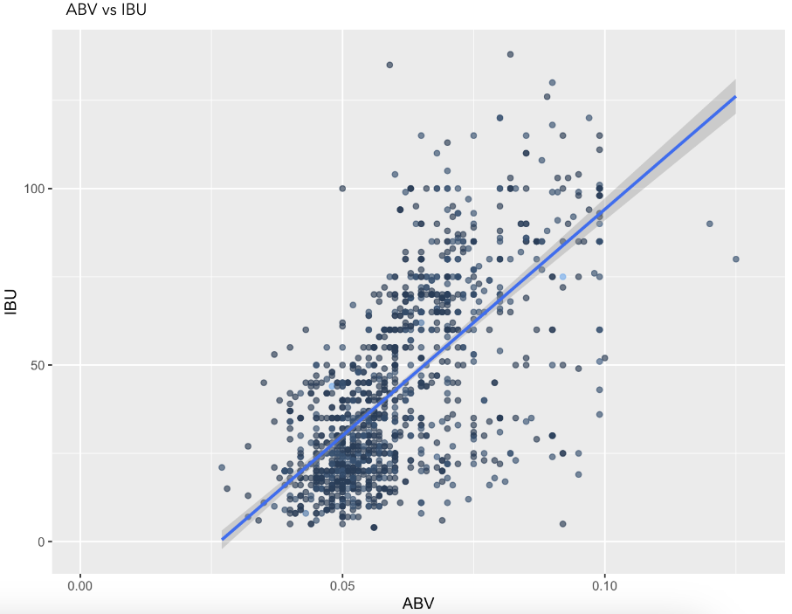
Relationship between ABV and IBU
There seems to be a positive linear trend visible between alcohol content and bitterness
Notes:
R: Is there a relationship between bitterness and the alcoholic content of a beer?

Slide 19

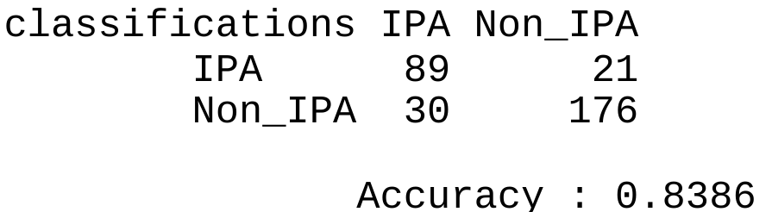
Predicting Ale Type Using KNN
Clustering models were trained to predict if Ale's would be classified as Indian Pale Ales or not.
Deciding Factors: ABV, IBU
89 IPAs were properly labelled as IPAs
Notes:
Joel
Discuss caveats of test:
Ran limited number of simulations (100) due to time and computer constraints.
Non-optimized models show lower accuracies bordering on 80%

Slide 20
Predicting Ale Type Using KNN
Clustering models were trained to predict if Ale's would be classified as Indian Pale Ales or not.
Deciding Factors: ABV, IBU
89 IPAs were properly labelled as IPAs
176 Non-IPAs were properly labelled as Non-IPA
Notes:
Joel
Discuss caveats of test:
Ran limited number of simulations (100) due to time and computer constraints.
Non-optimized models show lower accuracies bordering on 80%

Slide 21
Predicting Ale Type Using KNN
Clustering models were trained to predict if Ale's would be classified as Indian Pale Ales or not.
Deciding Factors: ABV, IBU
Final Model reached nearly 84% accuracy!
Notes:
Joel
Discuss caveats of test:
Ran limited number of simulations (100) due to time and computer constraints.
Non-optimized models show lower accuracies bordering on 80%

Slide 22
Predicting Ale Type Using KNN
Clustering models were trained to predict if Ale's would be classified as Indian Pale Ales or not.
Deciding Factors: ABV, IBU
Final Model reached nearly 84% accuracy!
Notes:
Joel
Discuss caveats of test:
Ran limited number of simulations (100) due to time and computer constraints.
Non-optimized models show lower accuracies bordering on 80%

Slide 23

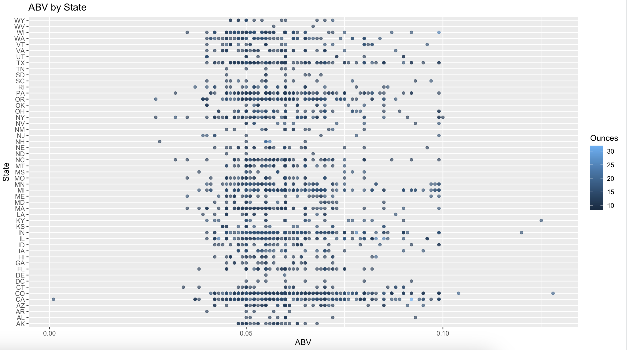
ABV by State
Notes:
I think this would be the best EDA to include. It shows the expected ranges of ABV for a large variety of beer by state. Also shows that most beer styles have similar ABV ranges . Shows that most beers are around 10 oz, and fall within a range of ABV

Slide 24
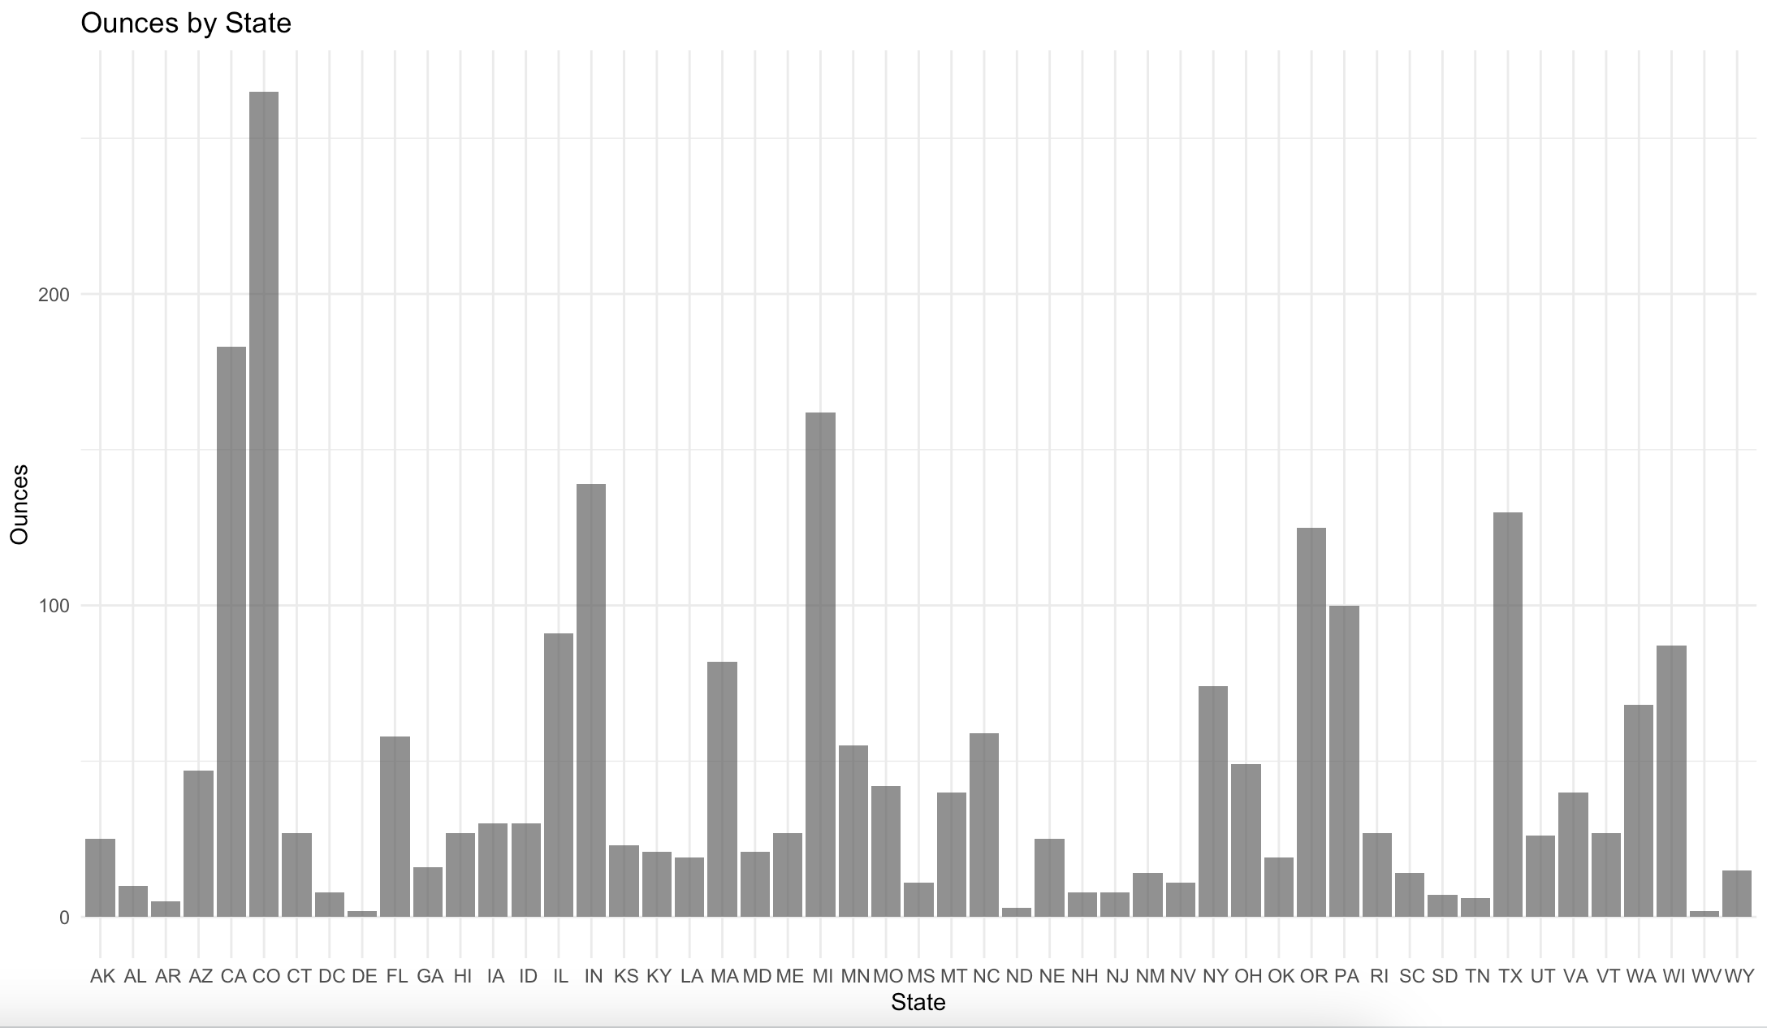
Ounces by State
Notes:
It looks like Colorado and California produce the beer with the most volume (Oz); they also have the most breweries (as mentioned earlier). We think this would be the Top 2 keystone states for production within the US. Something to keep in mind regarding supply chain issues if they were to arise

Slide 25
Ounces by State
Colorado and California produce beer with most volume
Notes:
It looks like Colorado and California produce the beer with the most volume (Oz); they also have the most breweries (as mentioned earlier). We think this would be the Top 2 keystone states for production within the US. Something to keep in mind regarding supply chain issues if they were to arise

Slide 26
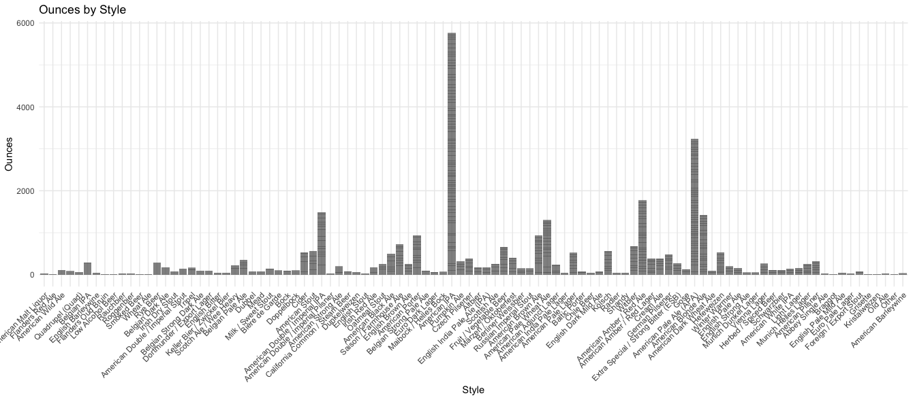
Style and Ounces relationship
Notes:
It looks like the American IPA style has the most ounces (style wise); American Pale Ale is runner up

Slide 27
Style and Ounces relationship
American IPA Style has the most ounces, with American Pale Ale being a runner up
Notes:
It looks like the American IPA style has the most ounces (style wise); American Pale Ale is runner up

Slide 28
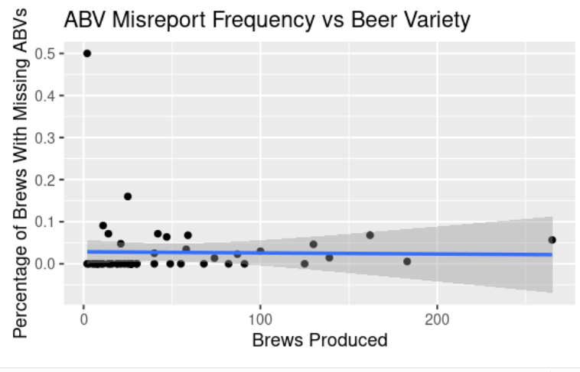
ABV Misreporting and Beer Variety
Flat line, not much evidence of relationship
Notes:
No signs that higher beer variety is correlated with misreport rate

Slide 29
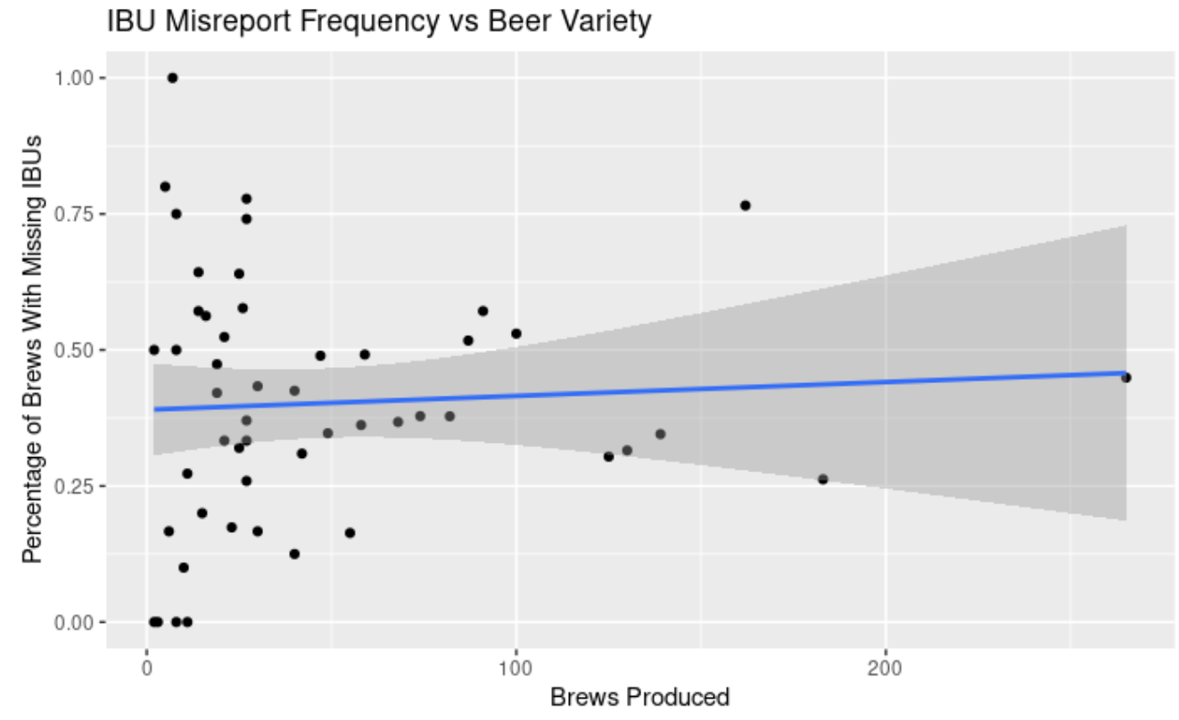
IBU Misreporting and Beer Variety
Slight linear relationship?
Regression analysis needed to determine if correlation exists …
Notes:
No signs that higher beer variety is correlated with misreport rate

Slide 30
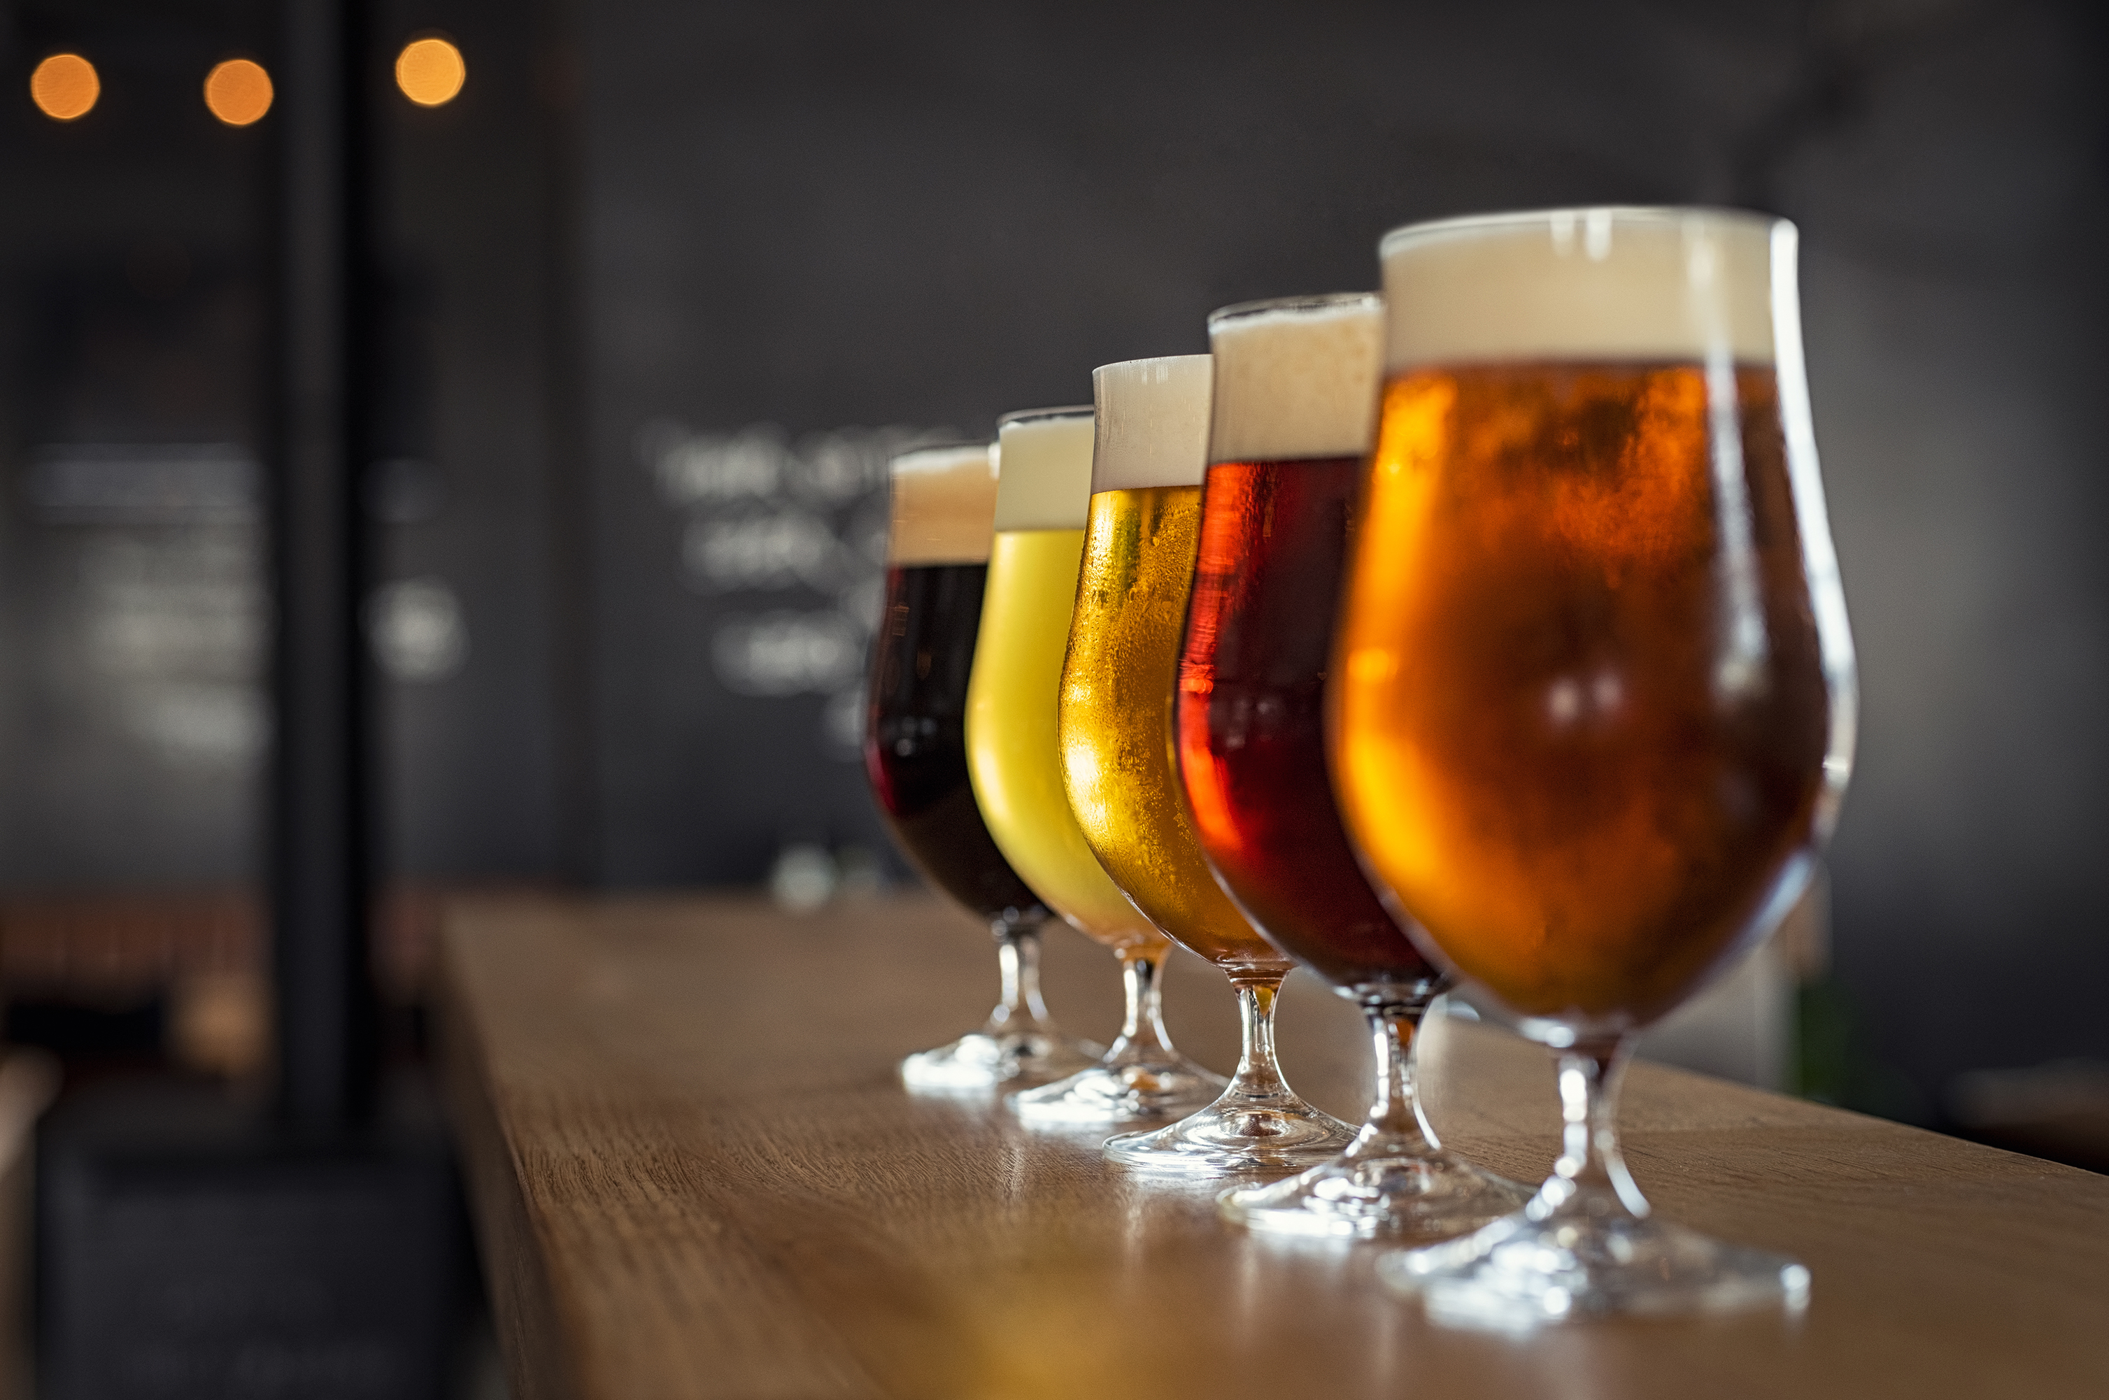
Thank You!
jlaskow@mail.smu.edu
rkarthikeyan@mail.smu.edu
Notes:
R: This concludes our presentation. Thank you for your time and we look forward to empowering Budweiser with data-driven wisdom.
If you have any questions, please feel free to reach out to any of us, our emails are on the screen. Thank you

